Slide 1
Edubridge
Projects
Zomato Restaurants Analysis in Bangalore City

Slide 2
Introduction
One of the most rapid advances in the e-commerce sector has been online food delivery. This industry has changed the way people think about food because customers can now choose from a wide range of cuisines from a variety of restaurants listed online, globally and at any time. Below is the mentioned list of online food companies with their country of origin and year of establishment

Slide 3
Problem Statement
The basic idea of analyzing the Zomato dataset is to get a fair idea about the factors affecting the aggregate rating of each restaurant, establishment of different types of restaurant at different places, Bengaluru being one such city has more than 12,000 restaurants with restaurants serving dishes from all over the world. With each day new restaurants opening the industry has`nt been saturated yet and the demand is increasing day by day. Inspite of increasing demand it however has become difficult for new restaurants to compete with established restaurants. Most of the people here are dependent mainly on the restaurant food as they don`t have time to cook for themselves. What kind of a food is more popular in a locality. Do the entire locality loves vegetarian food.

Slide 4
Some of the common questions come to every people in mind are –
When will this food order get delivered?
How much time will the restaurant take to prepare this food order?
Who should be the delivery partner (DP) for this food order?
Is this photo a food shot?
Is the DP properly groomed?
Is the DP wearing a mask?
Is this review a fake review?

Slide 5
Methodology
Import the Required Library
import numpy as np
import pandas as pd
import matplotlib.pyplot as plt
import seaborn as sns
from sklearn.linear_model import LogisticRegression
from sklearn.linear_model import LinearRegression
from sklearn.model_selection import train_test_split
from sklearn.metrics import classification_report
from sklearn.metrics import confusion_matrix
from sklearn.metrics import r2_score
Loading the Data set of “Zomato.csv”
Pd.read_csv

Slide 6
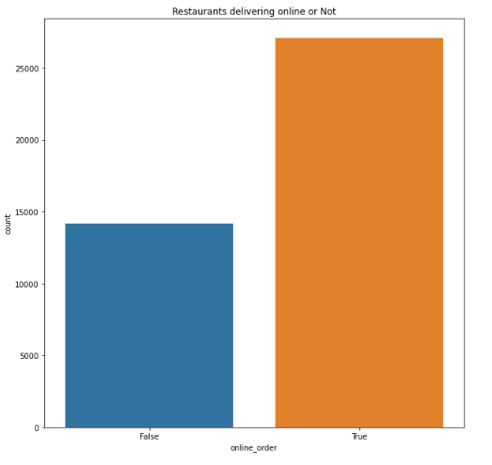
Data Cleaning
Deleting Un required columns in data set for cleaning data
Some columns name rename because handle to easy way
Dropping duplicates in the data sets.
Remove the nan values from the dataset
Remove the 0 value from data set
Transformation some data value like cost value convert in to float value.

Slide 7
Data Visualization
Using plots to find relations between the features
Restaurants delivering Online or not
Restaurants allowing table booking or not
Table booking Rate vs Rate
Best Location
Relation between Location and Rating
Restaurant Type
Gaussian Rest type and Rating
Types of Services
Relation between Type and Rating
Cost of Restaurant
No. of restaurants in a Location
Restaurant type
Most famous restaurant chains in Bengaluru

Slide 8
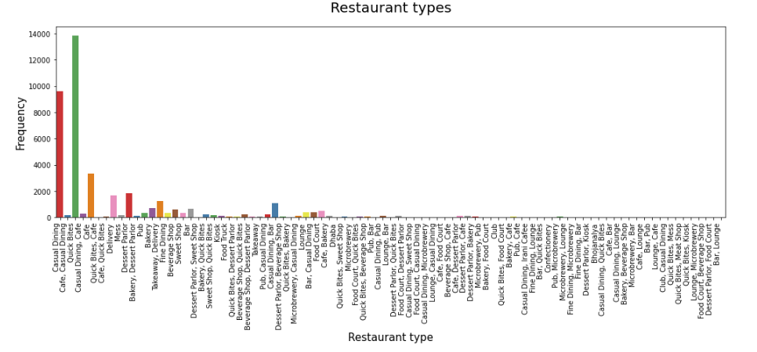
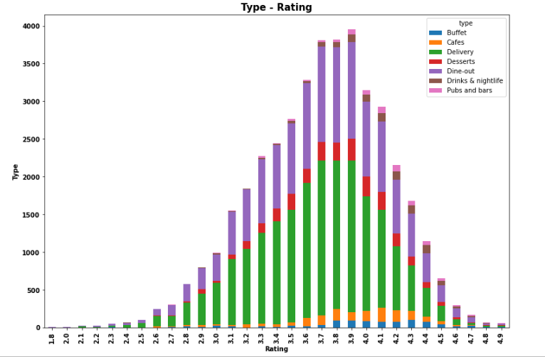
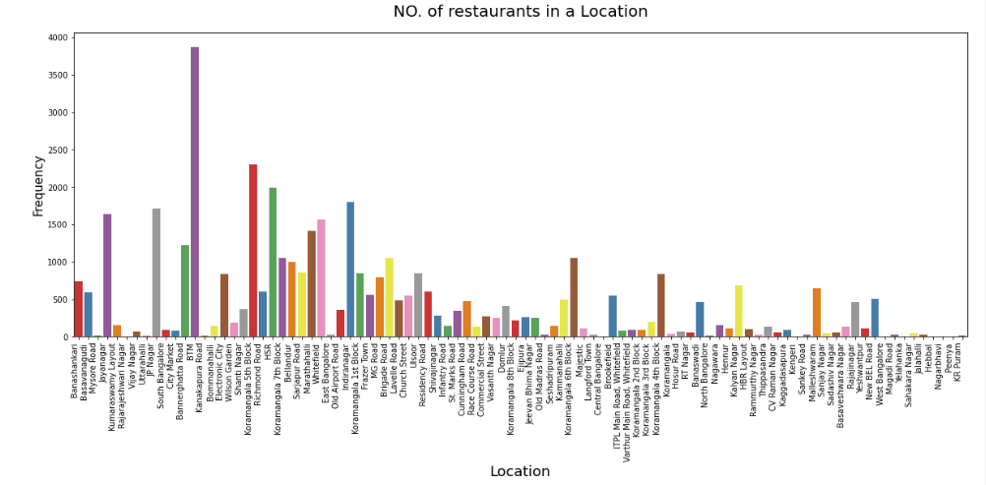
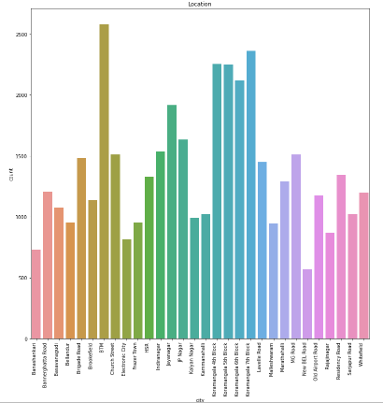
Restaurants type/ Frequency
Rating /type
Location/ Frequency
City/ Count

Slide 9
Regression Analysis
I used regression analysis because first it is supervised data set and second data set has true false columns, which was part of analysis.
Regression Analysis process
Linear Regression
Decision Tree Regression
Random Forest Regression

Slide 10
Inferences
The dataset is skewed towards India and doesn't represent the complete data of restaurants worldwide.
Restaurants rating is categorized between 1-5
Connaught Palace has maximum restaurants listed on Zomato but in terms of online delivery acceptance BTM area seems to be doing better.
The top-rated restaurants seem to be getting a better rating on the following cuisine
There is no relation between cost and rating. Some of the best-rated restaurants are low on cost and vice versa.
On common Eateries, For Breakfast and Coffee location, Indian restaurants seem to be better rated but for Fast food chain and Ice cream parlors, American restaurants seem to be doing better.

Slide 11
References
https://www.researchgate.net/publication/350089083_SWOC_ANALYSIS_OF_ZOMATO_-A_CASE_OF_ONLINE_FOOD_DELIVERY_SERVICES
https://www.kaggle.com/shrutimehta/zomato-restaurants-data
https://pandas.pydata.org/docs/user_guide/index.html
https://matplotlib.org/3.3.1/users/index.html
https://seaborn.pydata.org/tutorial.html
https://github.com/JovianML/opendatasets

Slide 12
THANK YOU

